Slide 1
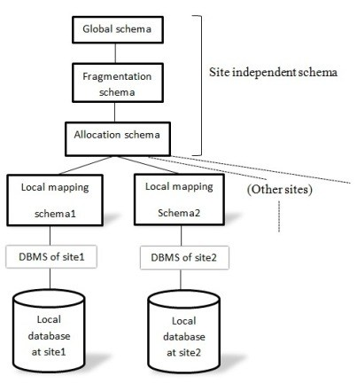
REFERENCE ARCHITECTURE FOR DISTRIBUTED DATABASE

Slide 2
Global schema defines all the data Which are contained in the distributed database as if the database were not distributed at all. The Global schema consists of the definition of a set of global relations.
Each global relation can be split into several non overlapping portions which are called fragments. The mapping between global relations and fragments is defined in the fragmentation schema. This mapping is one to many.
Fragments are logical portions of global relations which are physically located at one or several sites of the network.
The allocation schema defines at which site(s) a fragment is located.
The Local mapping schema maps fragments in the allocation schema onto external objects in the local database.

Slide 3
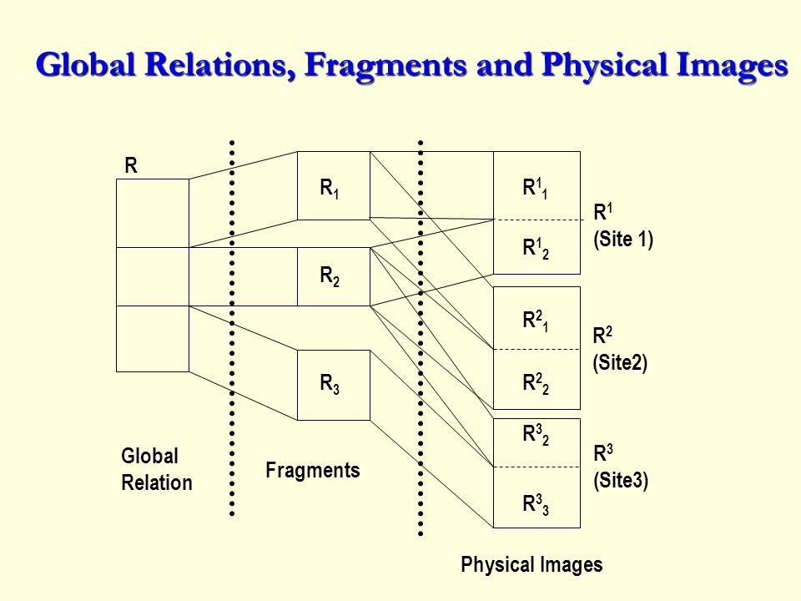

Slide 4
Distribution transparency
Distribution transparency is the property of distributed databases by the virtue of which the internal details of the distribution are hidden from the users. The DDBMS designer may choose to fragment tables, replicate the fragments and store them at different sites. However, since users are oblivious of these details, they find the distributed database easy to use like any centralized database.
The three dimensions of distribution transparency are −
Location transparency
Fragmentation transparency
Replication transparency

Slide 5
Location Transparency
Location transparency ensures that the user can query on any table(s) or fragment(s) of a table as if they were stored locally in the user’s site. The fact that the table or its fragments are stored at remote site in the distributed database system, should be completely oblivious to the end user. The address of the remote site(s) and the access mechanisms are completely hidden.
In order to incorporate location transparency, DDBMS should have access to updated and accurate data dictionary and DDBMS directory which contains the details of locations of data.

Slide 6
Fragmentation Transparency
Fragmentation transparency enables users to query upon any table as if it were unfragmented. Thus, it hides the fact that the table the user is querying on is actually a fragment or union of some fragments. It also conceals the fact that the fragments are located at diverse sites.
This is somewhat similar to users of SQL views, where the user may not know that they are using a view of a table instead of the table itself.

Slide 7
Replication Transparency
Replication transparency ensures that replication of databases are hidden from the users. It enables users to query upon a table as if only a single copy of the table exists.
Replication transparency is associated with concurrency transparency and failure transparency. Whenever a user updates a data item, the update is reflected in all the copies of the table. However, this operation should not be known to the user. This is concurrency transparency. Also, in case of failure of a site, the user can still proceed with his queries using replicated copies without any knowledge of failure. This is failure transparency.

Slide 8
Combination of Transparencies
In any distributed database system, the designer should ensure that all the stated transparencies are maintained to a considerable extent. The designer may choose to fragment tables, replicate them and store them at different sites; all oblivious to the end user. However, complete distribution transparency is a tough task and requires considerable design efforts.

